Slide 1

LPFSA basics:
The perfect HSA companion for tax-free dental and vision
LPFSA
Notes:
Thanks for joining today to learn how you can save with a HealthEquity Limited Purpose Flexible Spending Account.

Slide 2


Save more for dental and vision expenses
A Limited Purpose Flexible Spending Account (LPFSA) lets you use tax-free¹ money to pay for eligible dental and vision expenses.
¹LPFSAs are never taxed at a federal income tax level when used appropriately for qualified dental and vision expenses. Also, most states recognize LPFSA funds as tax deductible with very few exceptions. Please consult a tax advisor regarding your state’s specific rules.
Notes:
Limited Purpose Flexible Spending Accounts, or LPFSAs are employer-sponsored tax-advantaged accounts that let you use pre-tax dollars to pay for eligible dental and vision expenses.​
​
An LPFSA can pair with your HSA-qualified health plan (sometimes known as a High Deductible Health Plan) and Health Savings Account to cover your dental and vision needs, while helping you boost your long-term health savings. ​
​Note that if you have a healthcare Flexible Spending Account, your vision and dental expenses can be covered by that account and you are not eligible for an LPFSA if you have a healthcare Flexible Spending Account.

Slide 3




Get more flexibility with your LPFSA
Access annual contribution amount on day one
Fast, convenient payments and reimbursement
Pay for your spouse and dependents too
Notes:
​The LPFSA allows you to access your annual contribution amount on day one of your plan year.
It’s easy to spend your funds and then submit reimbursements.
Your Health Savings Account (HSA)-compatible or LPFSA covers qualified dental and vision expenses for you and your eligible dependents.​
​
Eligible dependents include a spouse, children under the age of 26, and children over age 26 who are tax dependents.​
Domestic partners are eligible if they qualify as tax dependents. ​
​

Slide 4

Tax-free contributions
$50
earned income
LPFSA
Without an LPFSA
Not taxed
Taxed
Keep your money
$10 to Uncle Sam
$50
$40
Spending power
Spending power
Estimated savings are based on an assumed combined federal and state income tax bracket of 20%. Actual savings will depend on your taxable income and tax status.
Notes:
​
The money you contribute to an LPFSA is not subject to payroll taxes and income taxes, so you end up paying less in taxes and taking home more of your paycheck.

Slide 5

Save $600+
Members who contribute the max to their LPFSA can save $600+ each year* on qualified medical expenses.
$3,400
x
20%
$680
*The example used is for illustrative purposes only; actual savings may vary. The figure is based on average tax rate of 20%, including state, federal and FICA taxes. Savings based on contributing the maximum family amount.
Notes:
By contributing the maximum amount to your flexible spending account, you can save up to $600 on qualified dental and vision expenses.

Slide 6
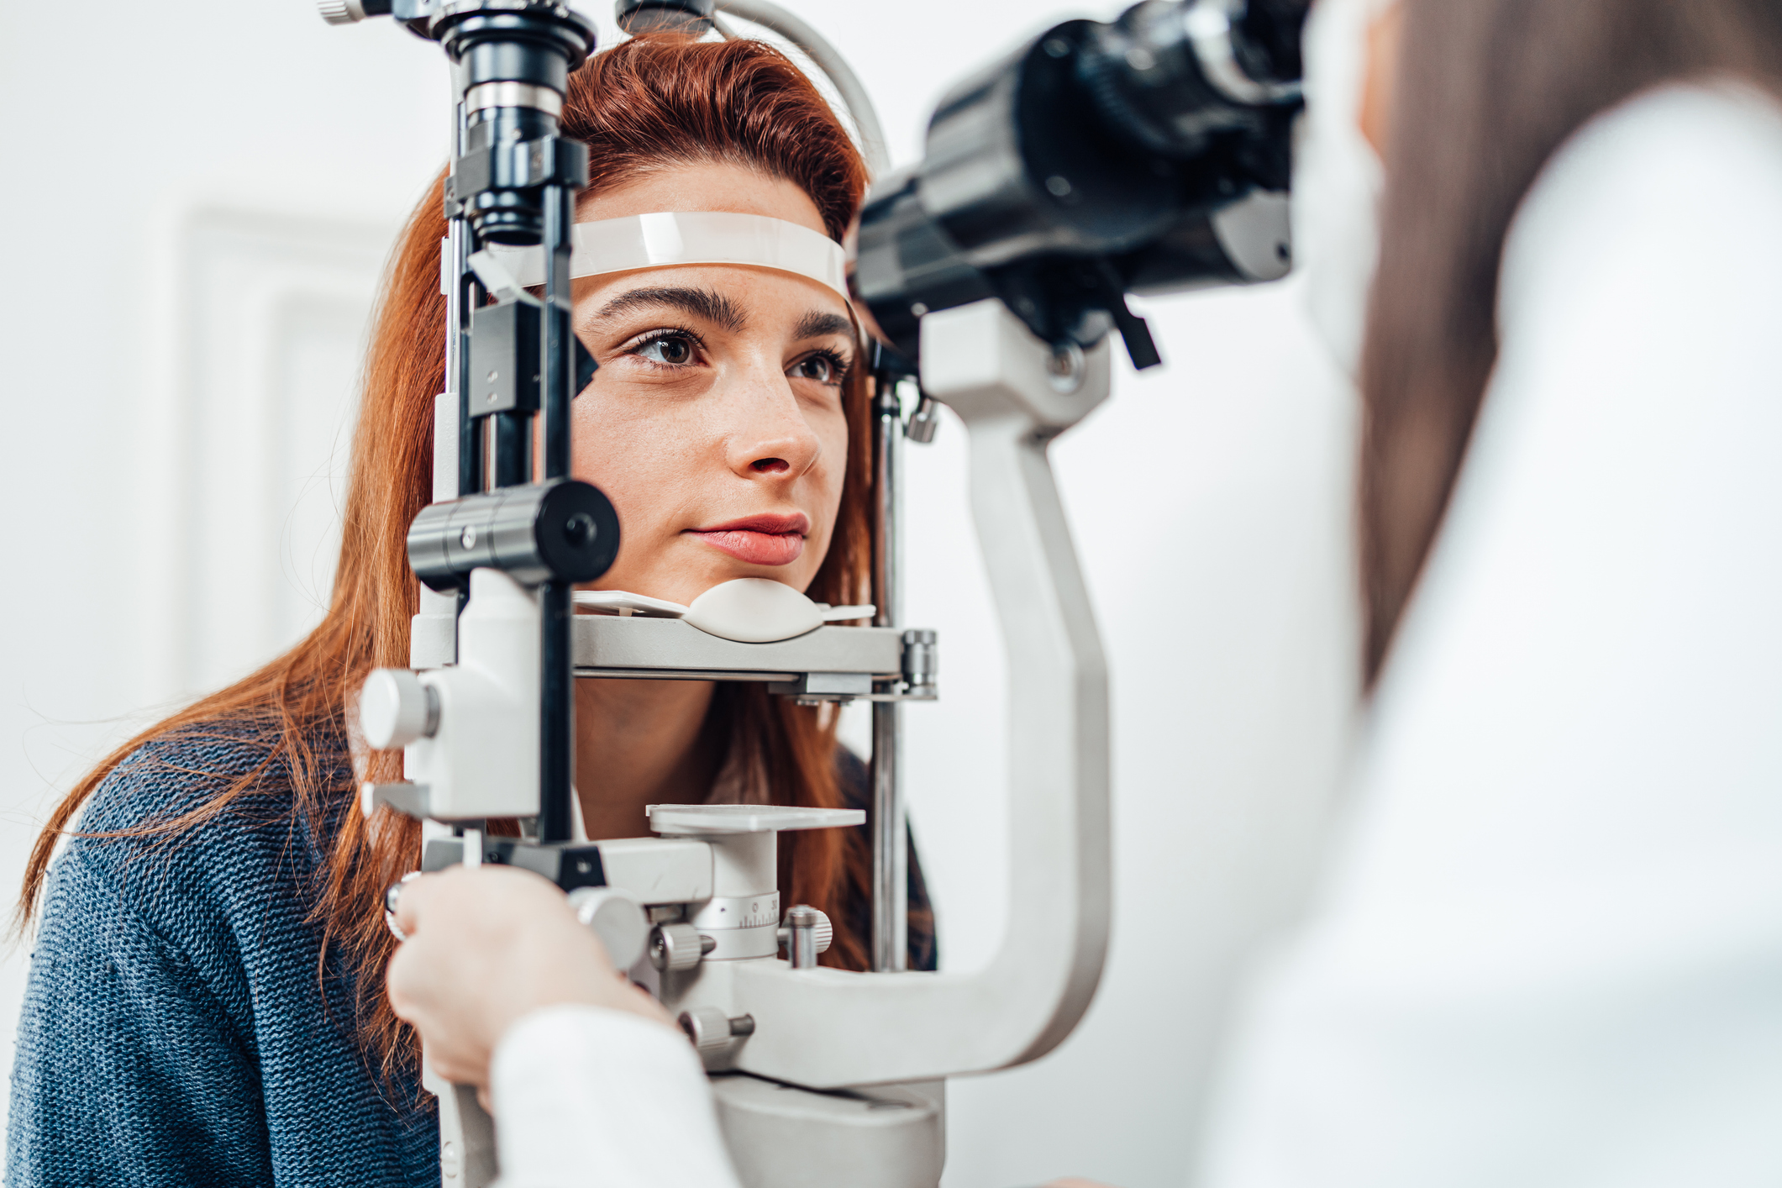



Save on LPFSA eligible expenses
Preventive care
Vision
Teeth cleaning
Wisdom teeth removal
Eye exams
Laser eye surgery
Prescription glasses
and contacts
Prescription sunglasses
Eyedrops
Dental
Orthodontia
Fillings and sealants
Mouth guards
Crowns and caps
HealthEquity.com/lpfsa-qme
Notes:
Here’s a few of the most popular eligible expenses using LPFSA funds.
You can find eligible expenses to spend your funds on at healthequity.com/lpfsa-qme​
​

Slide 7
The more you contribute the more you save
2026 Contribution limit | Tax savings*
$3,400 | $680
*Based on average state and federal income and payroll taxes. Actual savings will vary. Example for illustrative purposes only.
Notes:
How much can you contribute to an LPFSA?
The yearly contribution limits are set by the Internal Revenue Service.
​
The 2026 maximum contribution limit for the LPFSA is $3,400
​
​
​

Slide 8

Meet the Finches
HSA Family Plan
Along with their 401(k), they begin saving their HSA contributions to build a nest-egg for their future.
They contribute
$8,000
Their annual
tax savings*
$1,600
*Assumes the Finches pay 20% of their income in federal, State and social security taxes. Actual tax savings will depend on your HSA contributions, applicable State tax rates and your personal tax situation. Please consult your tax adviser for details. The example used is for illustrative purposes only.
Parking benefit |
Contribution Limit $270 per month
He drives in to work each day,
paying for parking at a local
garage near his firm’s building.
Notes:
Let’s see how one family pairs their H.S.A. and LPFSA to maximize their tax savings and create long-term healthcare needs savings.
Spencer Finch has an HSA-qualified health plan and an HSA that he and his wife Melissa have previously used to pay for their family medical costs. ​
​
But recently, thinking about their long-term goals and retirement strategies, they’ve become interested in using Spencer’s employer benefit offering to add an LPFSA to cover their vision and dental expenses, while keeping their HSA funds for long-term savings. ​
The Finches decide to contribute to their H.S.A. as they’ve done each year. Investing their HSA funds may help create a nest-egg for their future, which can grow tax-free.​
​

Slide 9

They spend smarter
LPFSA Plan
Instead of using HSA funds for vision and dental expenses, the Finches decide to contribute to an LPFSA to cover their immediate needs.
They contribute
$3,000
Their annual
tax savings*
$600
*Assumes the Finches pay 20% of their income in federal and state taxes. Actual tax savings will depend on your LPFSA contributions, applicable State tax rates and your personal tax situation. Please consult your tax adviser for details. The example used is for illustrative purposes only. .
Parking benefit |
Contribution Limit $270 per month
He drives in to work each day,
paying for parking at a local
garage near his firm’s building.
Notes:
Melissa and Spencer decide to contribute $3,000 to their LPFSA plan for this year, to pay for Melissa getting LASIK eye surgery and for Spencer to get some dental work done, saving $600 in taxes.
By using the LPFSA funds for these dental and eye care needs, Spencer and Melissa can then save more of their HSA funds for long-term retirement healthcare needs.

Slide 10
A LPFSA can complement your HSA nicely if you are saving for the long-term
Consider these questions:
Do you need funds
at the start of the plan year
for dental and vision expenses, which an LPFSA provides?
Do you plan to maximize your
HSA contributions in order to have long-term savings?
LPFSA
Short-term spending
HSA
Long-term saving
Jan
Feb
Mar
Apr
May
Jun
Jul
Aug
Sep
Oct
Nov
Dec
Year 2
Year 3
Notes:
As the Finches contribute to both the HSA and LPFSA, they can use the LPFSA for dental and vision expenses, while saving more each year in their HSA.
You can consider whether an LPFSA will help you with start of plan year dental and vision expenses and allow you to maximize your HSA contributions for your long-term medical expenses.

Slide 11




Tips to spend smarter
Plan your spending
Save receipts
No double dipping
Notes:
There are a few tips to help ensure you maximize the savings available to you with an LPFSA. ​
​
Plan your spending—It’s important that you use your LPFSA funds before plan year end for qualified dental and vision expenses or lose them (unless there is a carryover offered with your plan).​
Save all your receipts; you will need them for reimbursements and to substantiate your expenses.​
Remember there is no double dipping: expenses reimbursed under your LPFSA cannot be reimbursed under any other plan or program, including an HSA​
​

Slide 12

Maximize your HSA contributions & use your LPFSA for expected dental and vision needs
Get your LPFSA funds at the start of the plan year
Invest your HSA funds
for the long-term²
Increase your annual tax savings by contributing to both
Which of the LPFSA benefits, paired with an HSA, do you feel you’ll value most?
²Investments are subject to risk, including the possible loss of the principal invested, and are not FDIC or NCUA insured, or guaranteed by HealthEquity, Inc. Investing through the HealthEquity investment platform is subject to the terms and conditions of the Health Savings Account Custodial Agreement and any applicable investment supplement. Investing may not be suitable for everyone and before making any investments, review the fund’s prospectus.
Notes:
We’d like to hear from you—which of the LPFSA benefits, paired with an HSA, do you feel you’ll value most?
Maximize your HSA contributions because you use your LPFSA for expected dental and vision needs
Get your dental and vision funds at the start of the plan year
Invest your HSA funds for the long-term OR
Increase your annual tax savings by contributing to both an HSA and LPFSA

Slide 13

What’s needed for reimbursement
Documentation that includes
the following should be provided:
  Names of providers
  Names of persons who
  received care or service
  Dates of service or care
  Descriptions of services
  Costs of service or care
Notes:
For quick processing of your claims, you can submit reimbursement requests online or on the mobile app. Be sure that documentation, like itemized statements from the provider or receipts, includes:
​
Names of providers​ who you received services or care from
Names of persons who received the services or care
Dates of service​ (not the date of billing)
Descriptions of services​--what specifically the patient received as services or care
And the Costs of services​
​
Note: Credit card receipts, canceled checks, and balance forward statements do not meet the requirements for acceptable documentation because they don’t include all of the necessary documentation details.​
​

Slide 14



HealthEquity makes saving easy
24/7 Member Services
via call or chat
On-the-go access with
our mobile app
Fast, convenient payment
and reimbursement
Notes:
HealthEquity makes saving easy, with our 24/7 member services’ availability, easy access mobile app, and convenient payment and reimbursement.
You can take a quick photo of your receipt or documentation with your smart phone, open up the mobile app, and submit a claim in a few easy steps.
Or you can submit LPFSA claims online in your account for reimbursement.
Log into your account, then select the type of claim you want to submit.
Go through the onscreen steps to complete the claim details and information.
You will then need to upload a digital image of your documentation. You must include the documentation or receipt information or your claim will not be processed for reimbursement.
Then review and submit your claim.

Slide 15
Get started today!
01
02
03
Sign up
Contribute
Access account
Enrollment dates:
<<start date>> - <<end date>>
Enroll here:
<<add custom URL>>
Choose election amount
for the year
Pre-tax through payroll
Amount withheld
from each paycheck is typically equal
Register and login at www.HealthEquity.com/login
Submit for reimbursement via the HealthEquity online tool or mobile app
Remember to save all receipts
Notes:
INSERT your enrollment dates and enrollment URL.
It’s easy to sign up, contribute, and use your limited purpose flexible spending account funds.​
​​
First you want to make sure you’re aware of your enrollment dates and where you need to enroll.​​
Then choose your election amount for the year (which typically cannot change)​​
​​
You’ll contribute pre-tax through payroll contributions and remember that you have your full amount of contribution funds available on the starting date of your plan year.​
​​
You will also want to register and log in at www.healthequity.com/login to start using your funds.​​
You can then submit reimbursement claims online or with the mobile app once you’ve registered your account. And downloaded the app.​
​

Slide 16


Questions?
We’re here for you 24/7
HealthEquity.com/Learn
Copyright © 2025 HealthEquity, Inc. All rights reserved.
HealthEquity does not provide legal, tax or financial advice.
Notes:
And remember, you can use your online or mobile account to chat live with Member Services.

Slide 18
Grace period
Up to an additional 2 ½ months
2025
2026
Notes:
[If applicable]​
​
Your organization offers a grace period, giving you up to an additional 2 ½ months to use the previous year’s FSA funds.

Slide 19
2026 Carryover
Up to $680
2025
2026
Notes:
[If applicable]​
​
Your organization offers a carryover, letting you roll over up to $680
in unused funds from one plan year to the following plan year.

